Slide 1

Module – 2 :
Function-Oriented Software Design
Software Engineering (SE) → CSEN3202 – CSE/BTech/6th Semester → Module-II → Prepared by : Nilina Bera, CSE, HITK

Slide 2
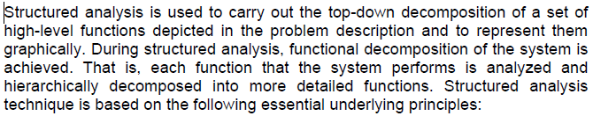
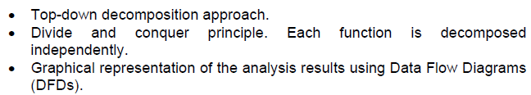
Function Oriented Software Design
Structured Analysis (not structured design)
Nilina Bera

Slide 3
Data Flow Diagram (DFD)
The DFD (also known as a bubble chart) is a hierarchical graphical model of a system that shows the different processing activities or functions that the system performs and the data interchange among these functions.
Each function is considered as a processing station (or process) that consumes some input data and produces some output data.
The system is represented in terms of the input data to the system, various processing carried out on these data, and the output data generated by the system.
A DFD model uses a very limited number of primitive symbols [as shown in fig.1(a)] to represent the functions performed by a system and the data flow among these functions.
Nilina Bera

Slide 4
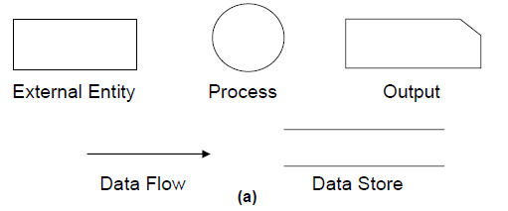
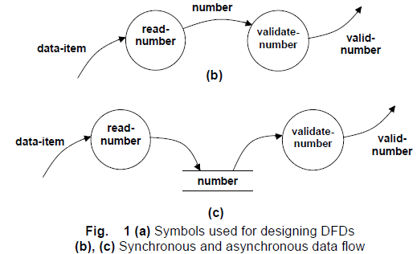
Data Flow Diagram (DFD)
Nilina Bera

Slide 5
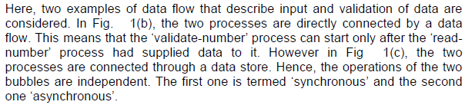
Data Flow Diagram (DFD)
Nilina Bera

Slide 6
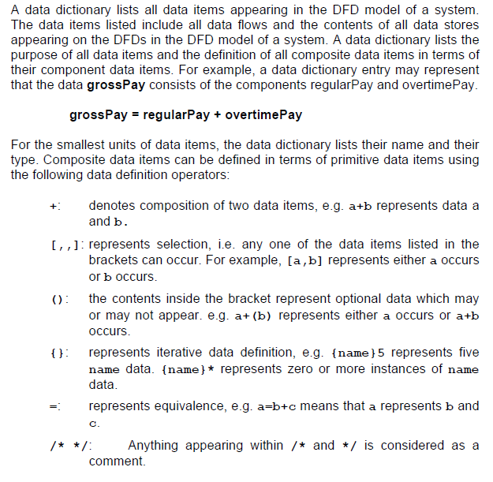
Data dictionary

Slide 7
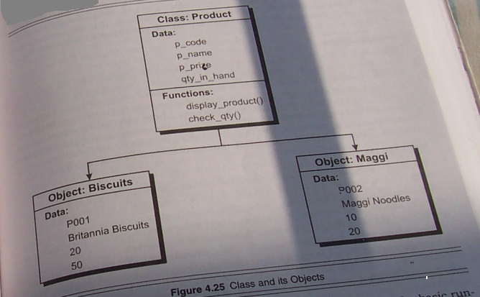
Object Oriented Software Design, let’s have a look at the class diagram
OBJECT-ORIENTED CONCEPTS – ENCAPSULATION, INHERITANCE, CONTAINERSHIP, POLYMORPHISM
Nilina Bera

